Slide 1
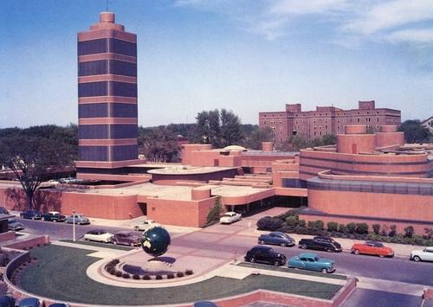
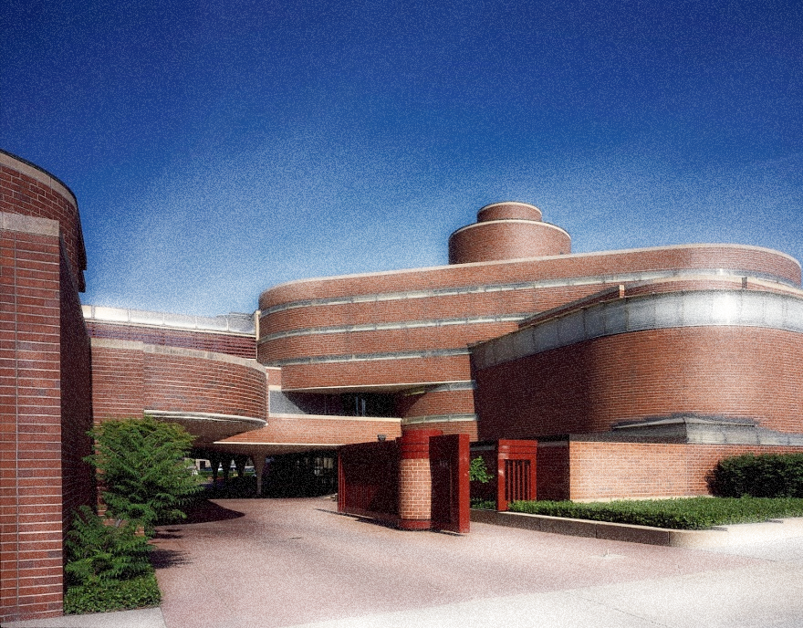
Johnson Wax Administration Building
Frank Lloyd Wright

Slide 2
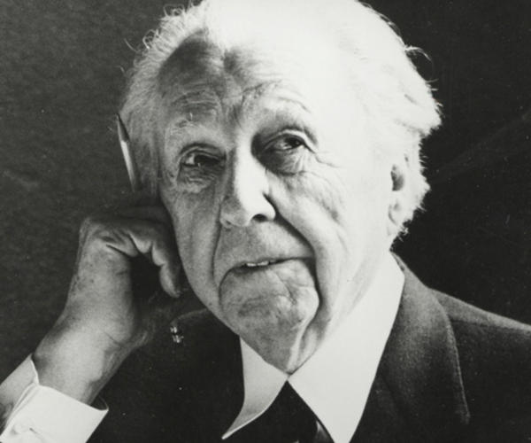
Frank Lloyd Wright
Frank Lloyd Wright was an American architect, interior designer, writer, and educator, who designed more than 1,000 structures, 532 of which were completed. He believed in designing structures that were in harmony with humanity and its environment, a philosophy he called organic architecture.
Wright also designed many of the interior elements of his buildings, such as the furniture and stained glass.

Slide 3
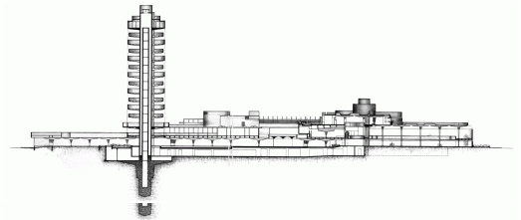
Johnson Wax Headquarters
Also known as the Johnson Wax Administration Building.
The building features Wright's interpretation of the streamlined Art Modern style popular in the 1930s. The building features many curvilinear forms and subsequently required over 200 different curved "Cherokee red" bricks to create the sweeping curves of the interior and exterior. The mortar between the bricks is raked in traditional Wright-style to accentuate the horizontality of the building.

Slide 4
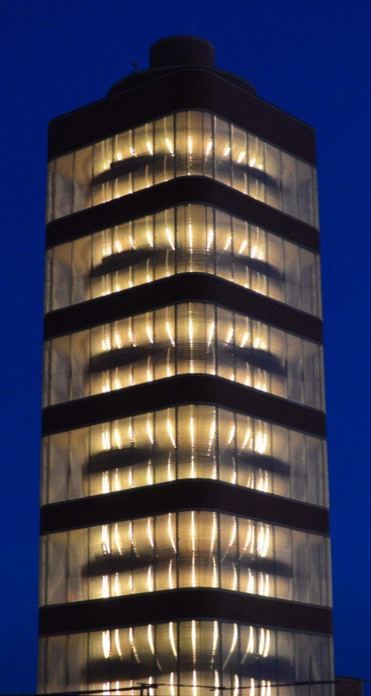

Slide 5
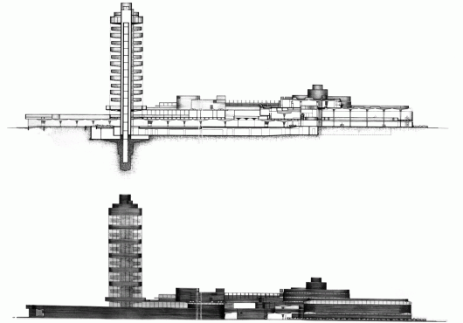
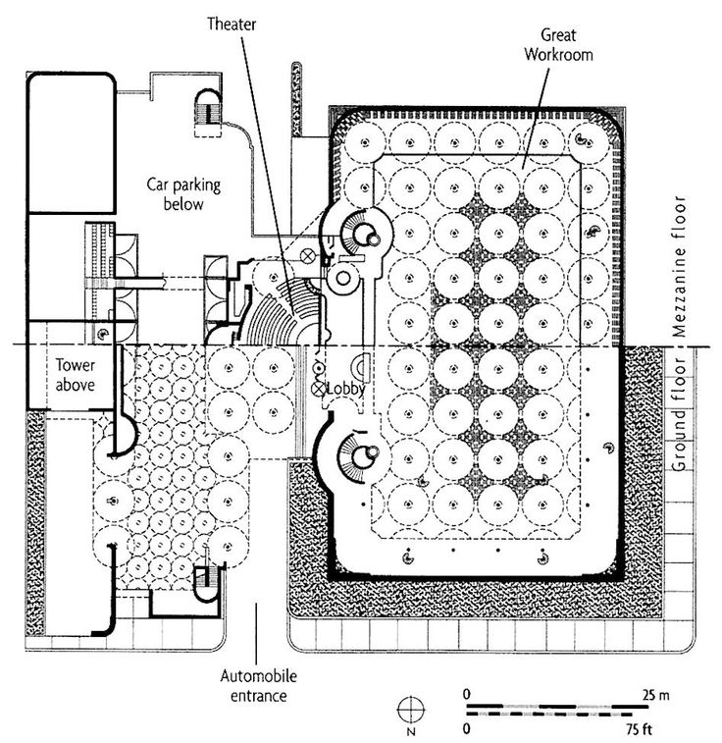

Slide 6
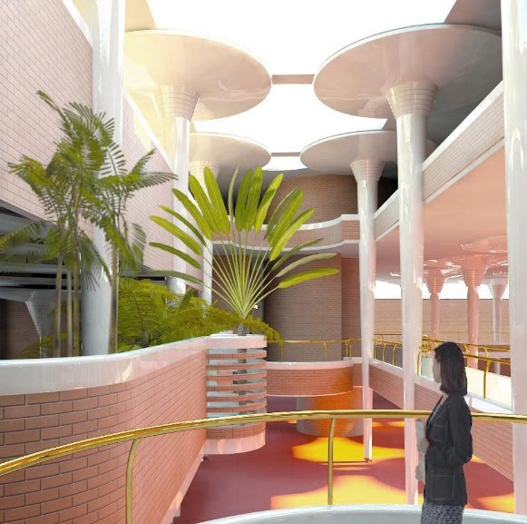
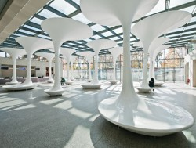
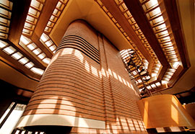
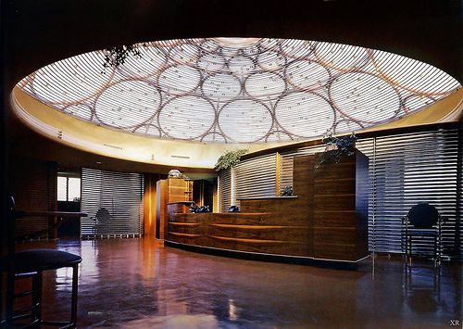
Skylight
The circular lily pads of concrete are woven together by a membrane of Pyrex glass tubing that illuminate spaces with natural light. The use of Pyrex glass tubing allowed for a lot of diffused light to enter the interior of the Johnson Wax Building.

