Slide 1
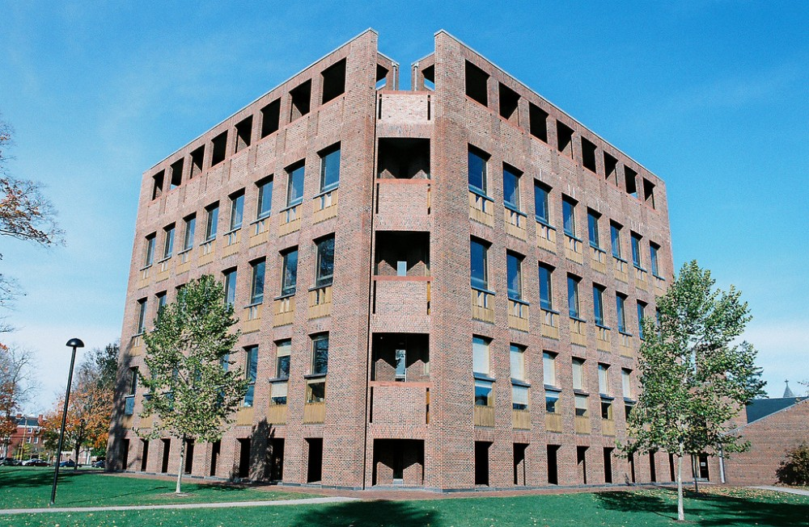
Exeter Library
Jose Solorzano

Slide 2
Info
The Phillips Exeter Library is located in New Hampshire and is the second largest high school library in the country
Built in 1971 by Louis Kahn.
The library hold about 160,000 volumes over nine levels.

Slide 3
Exterior

Slide 4
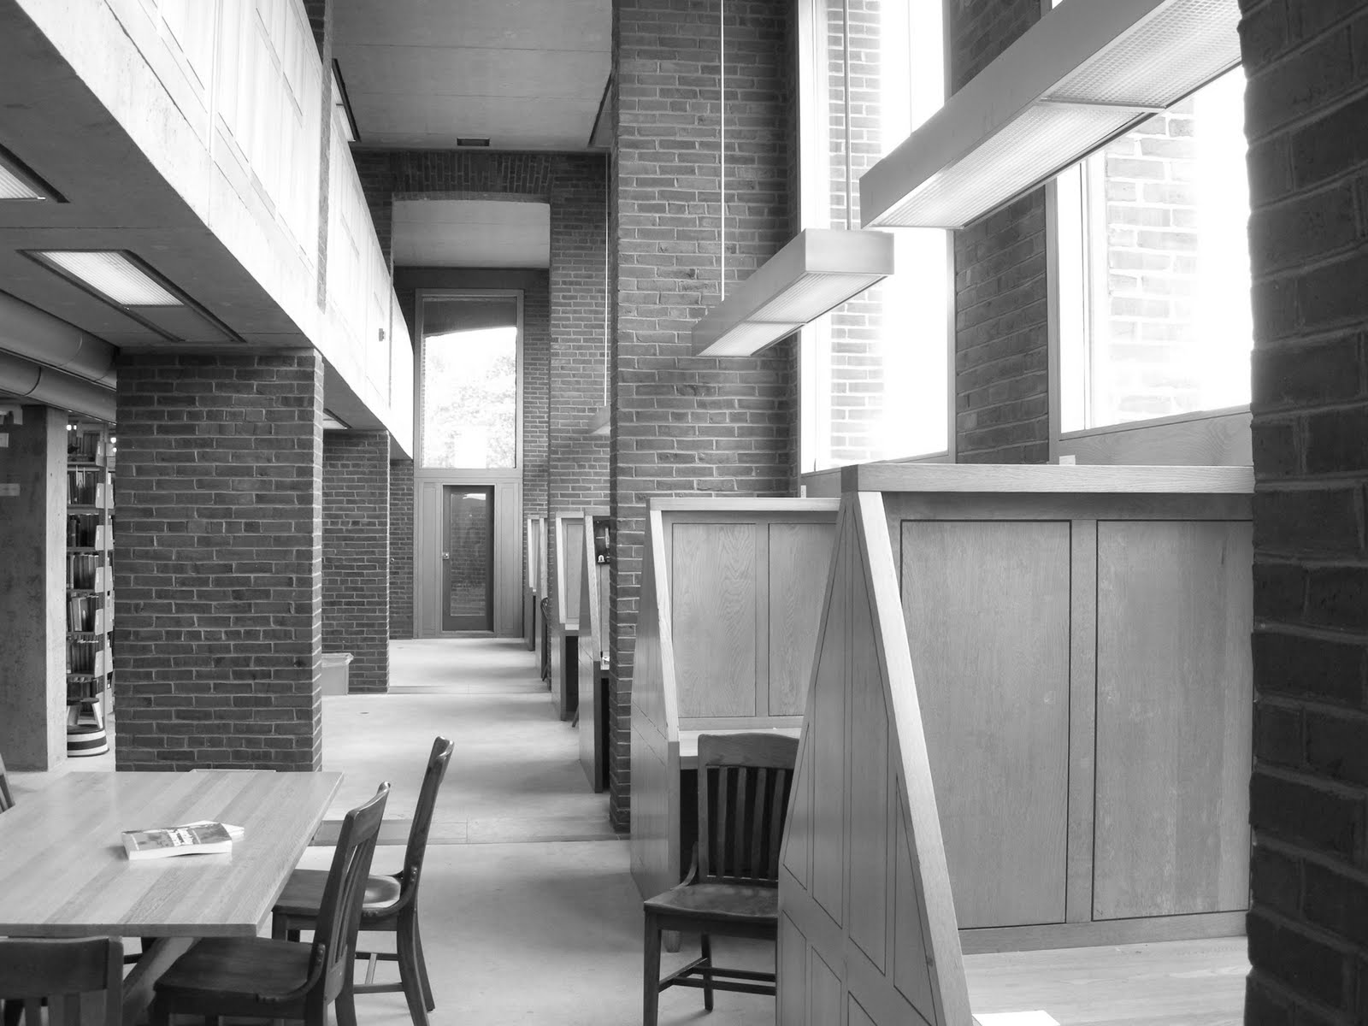

Slide 5
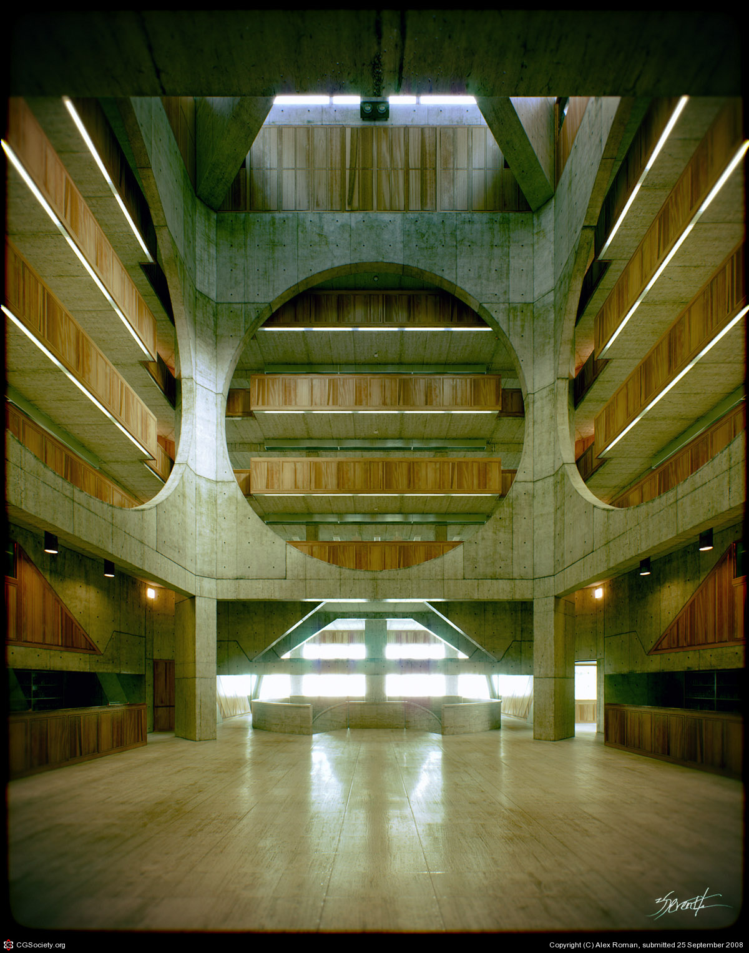
Interior

Slide 6
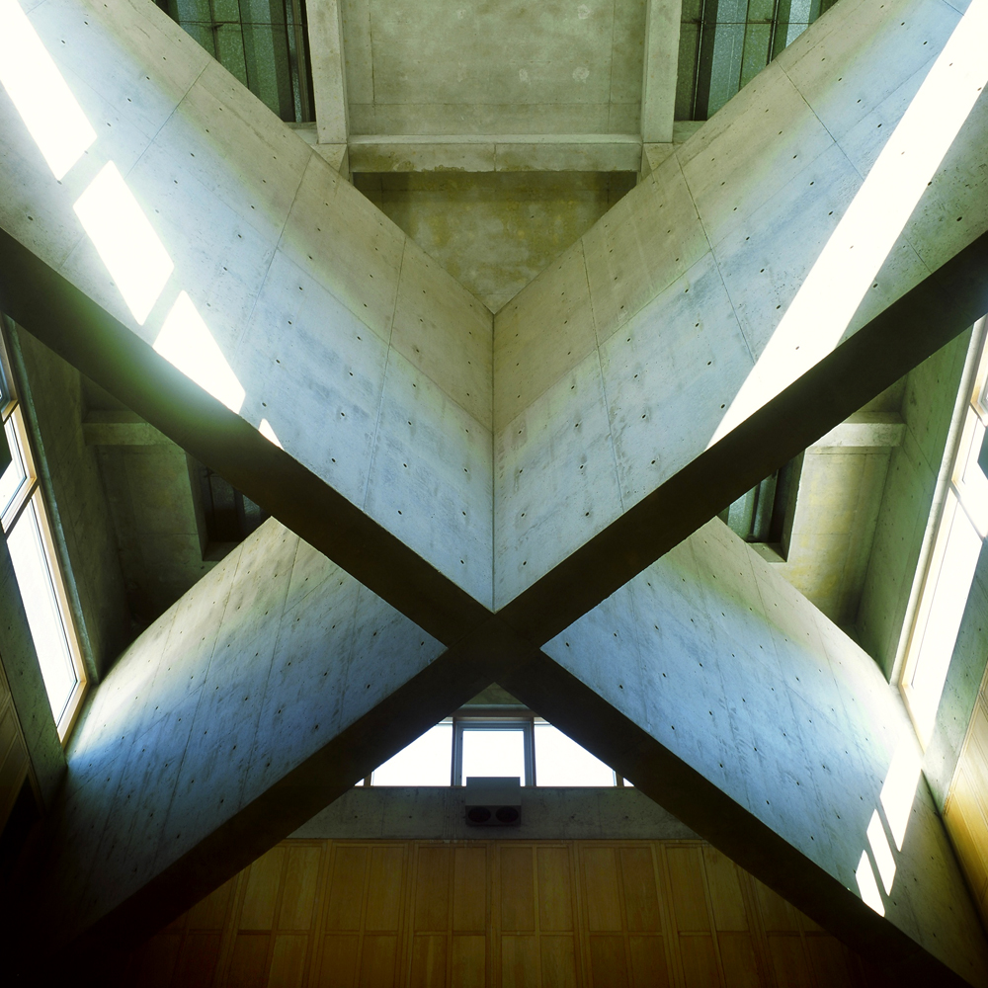

Slide 7
